Slide 1

Simulation and control of autonomous drone using Reinforcement Learning
CPSP Project – 2023/2024
Daniele Paccusse – Mattia Guazzaloca

Slide 2
Main Goals
Study PPO (Proximal Policy Optimization) Reinforcement learning algorithm and SKRL library
Create an environment using Isaac Gym where agents can interact
Implement a Neural Network to control the drone using camera images applying PPO
Design a reward function for obstacle avoidance
Train and test

Slide 3
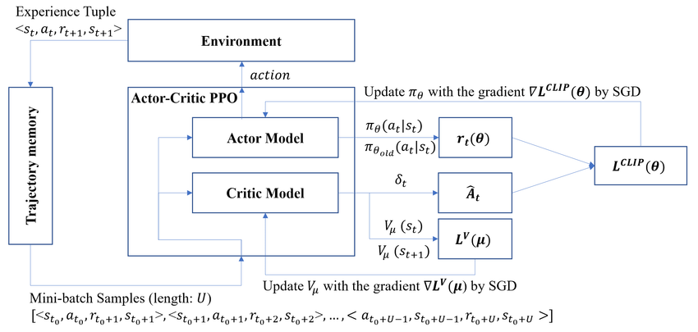
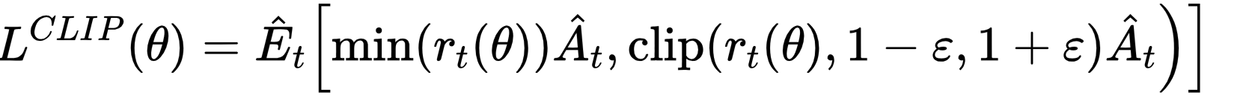
Proximal Policy Optimization (PPO)
Stochastic on-policy gradient algorithm
Actor-Critic method

Slide 4
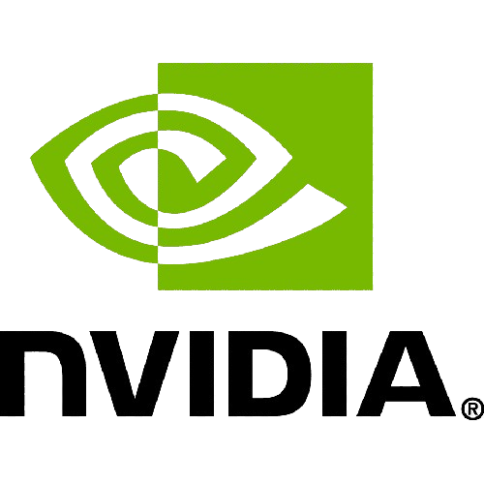


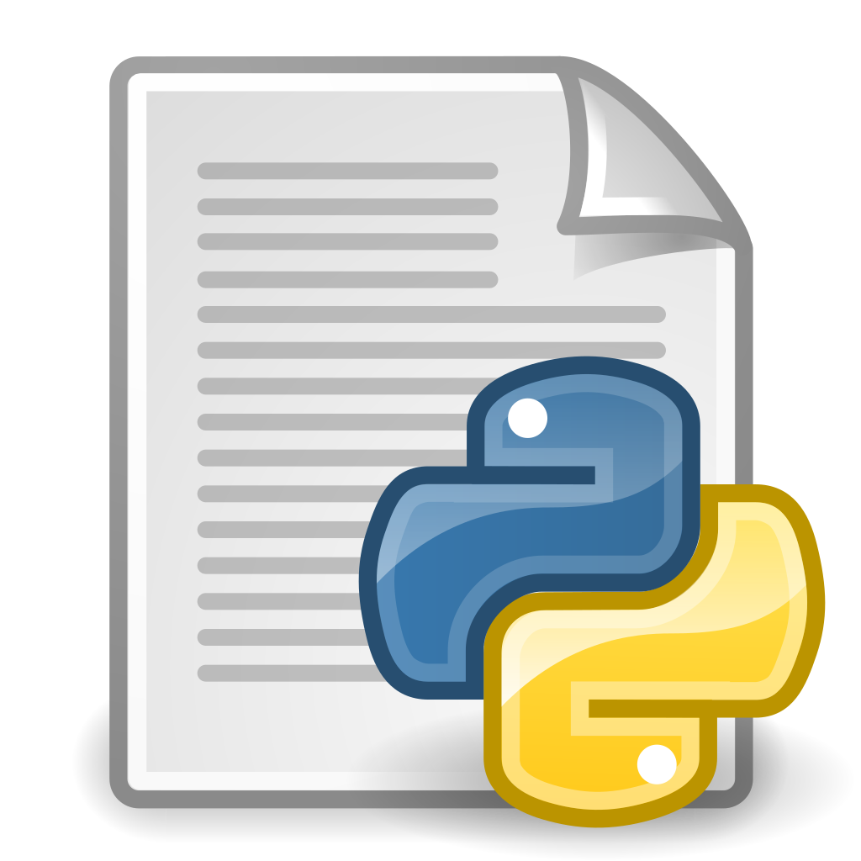
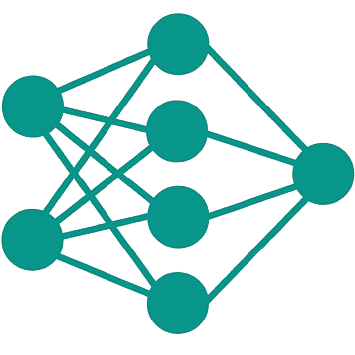

IsaacGym and SKRL interaction
IsaacGym
SKRL
torch.nn
quadrotor.py
ppo.py
- observation_space
- action_space
create_sim
pre_physics_step
post_physics_step
env
wrap_env
agent = PPO
parallel_trainer
controller
Proportional
+
Feedback linearization
actions

Slide 5
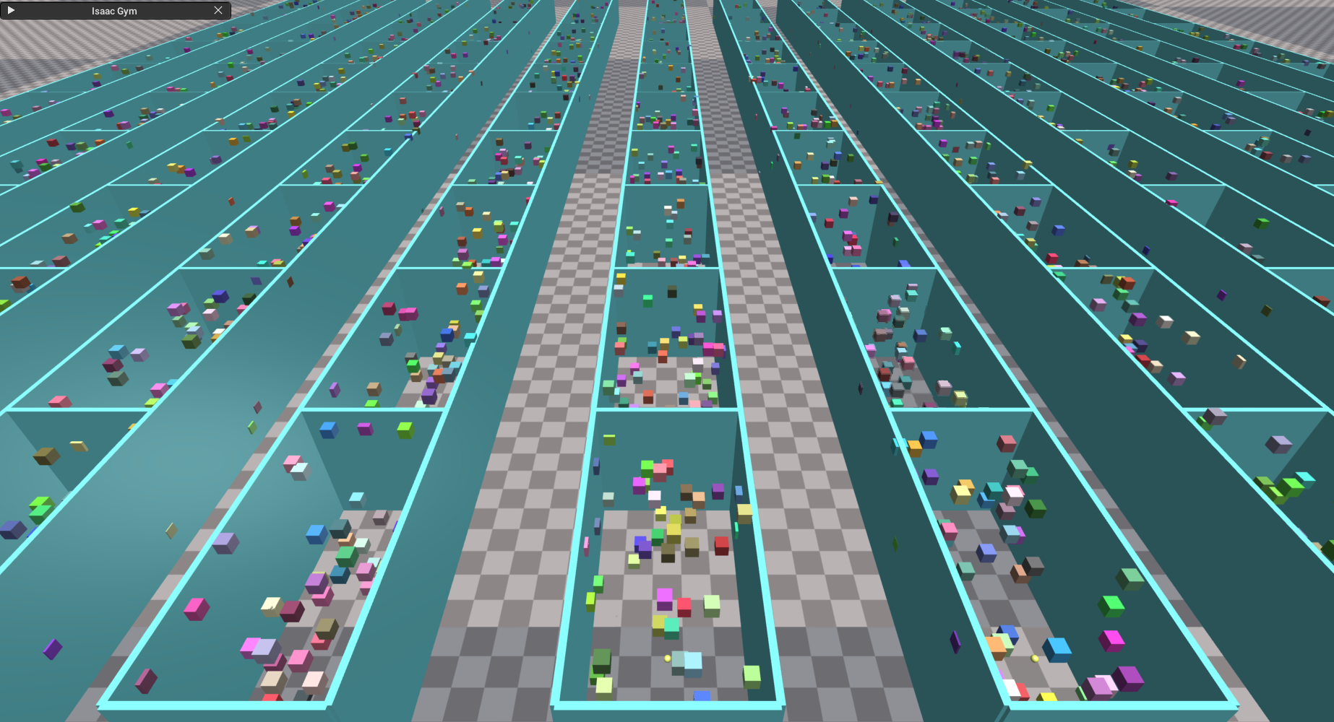
IsaacGym environment creation
quadrotor.py
create_sim
create_envs
create_ground_plane
load_assets: walls, obstacles URDF
For each environment:
create_actor: initial position, collision group
Each object is an actor

Slide 6
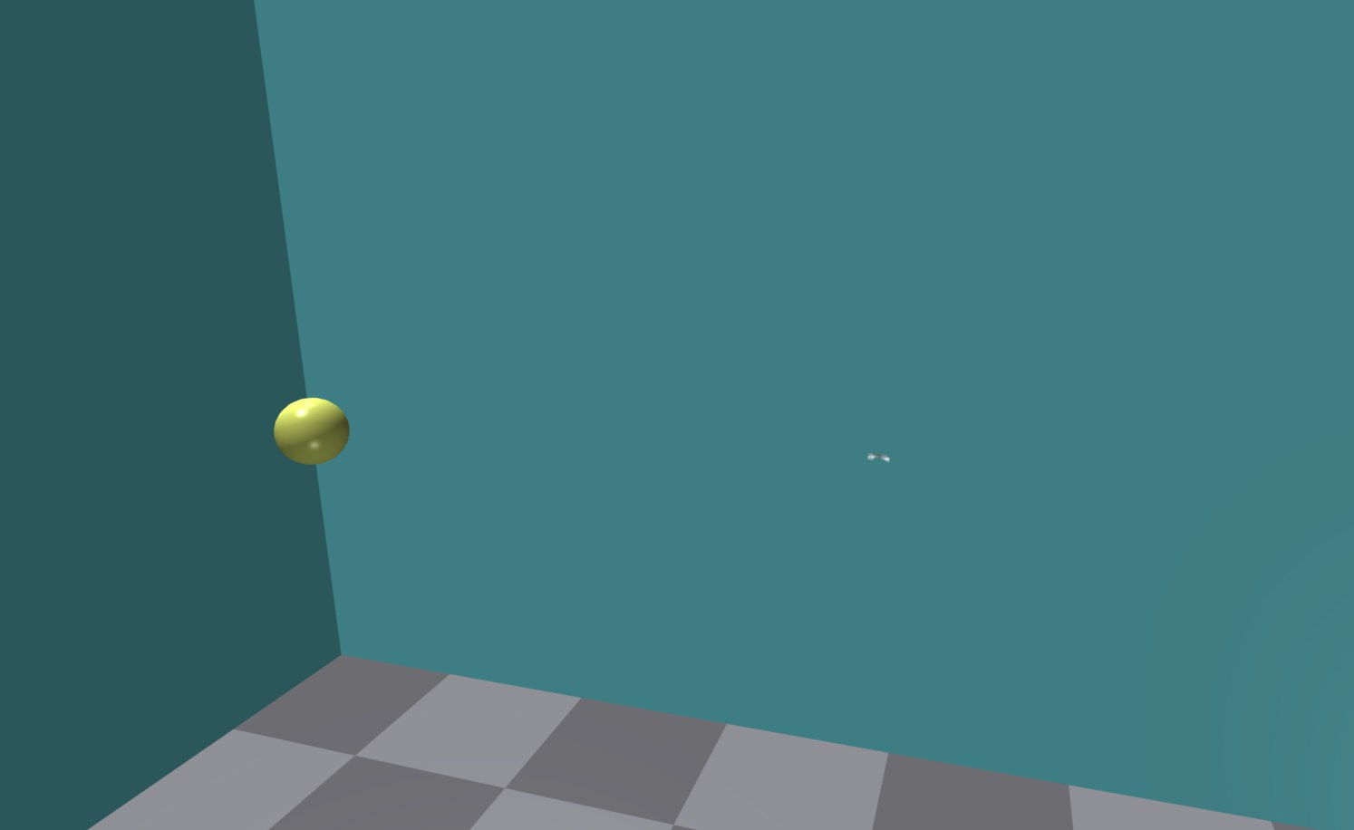


Reaching a target
Goal: reach a yellow sphere in a simulated rectangular room while avoiding collision with either the walls or the floor and without excessive movements
1
2
3
4
Environment Creation
SKRL Model Implementation
Reward Function Definition
Task Simulation & Training
Observations
Actions
Actor model
Critic model
Main parameters
Inputs
Outputs
Components
Reset array
Physics
Logging
Data collection

Slide 7
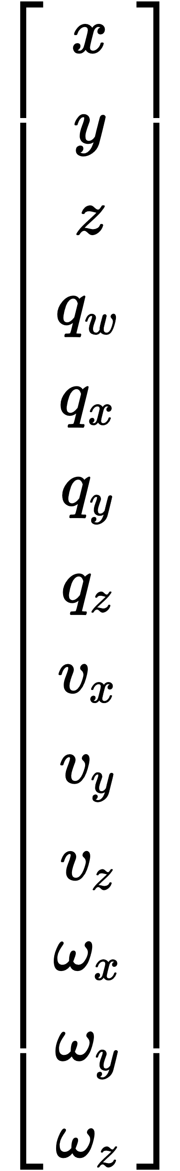
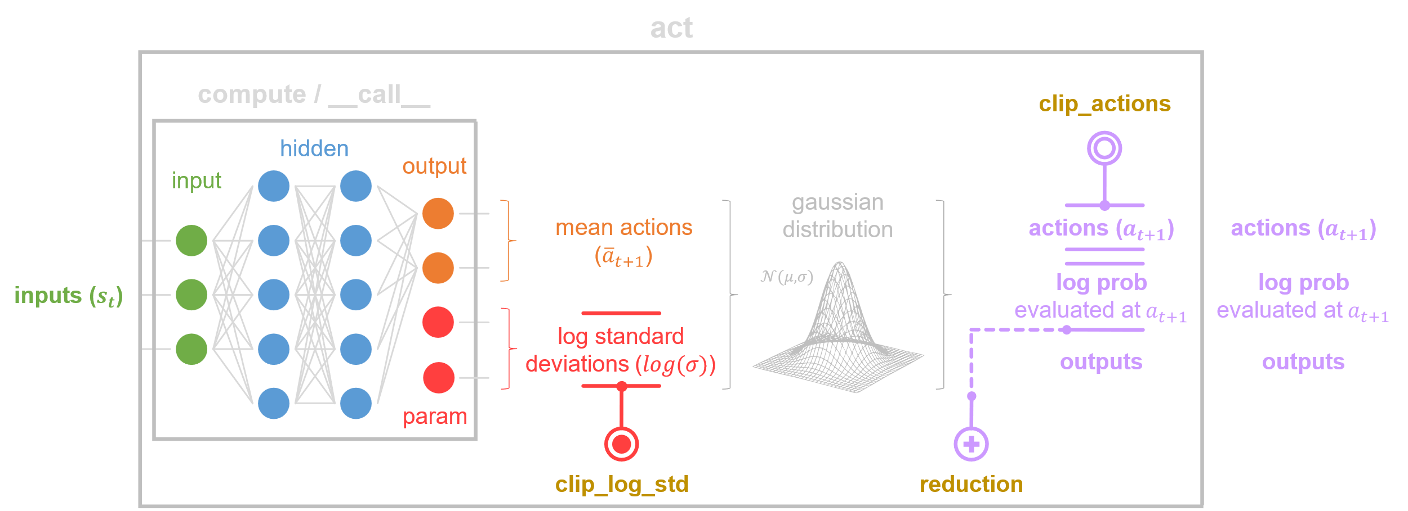
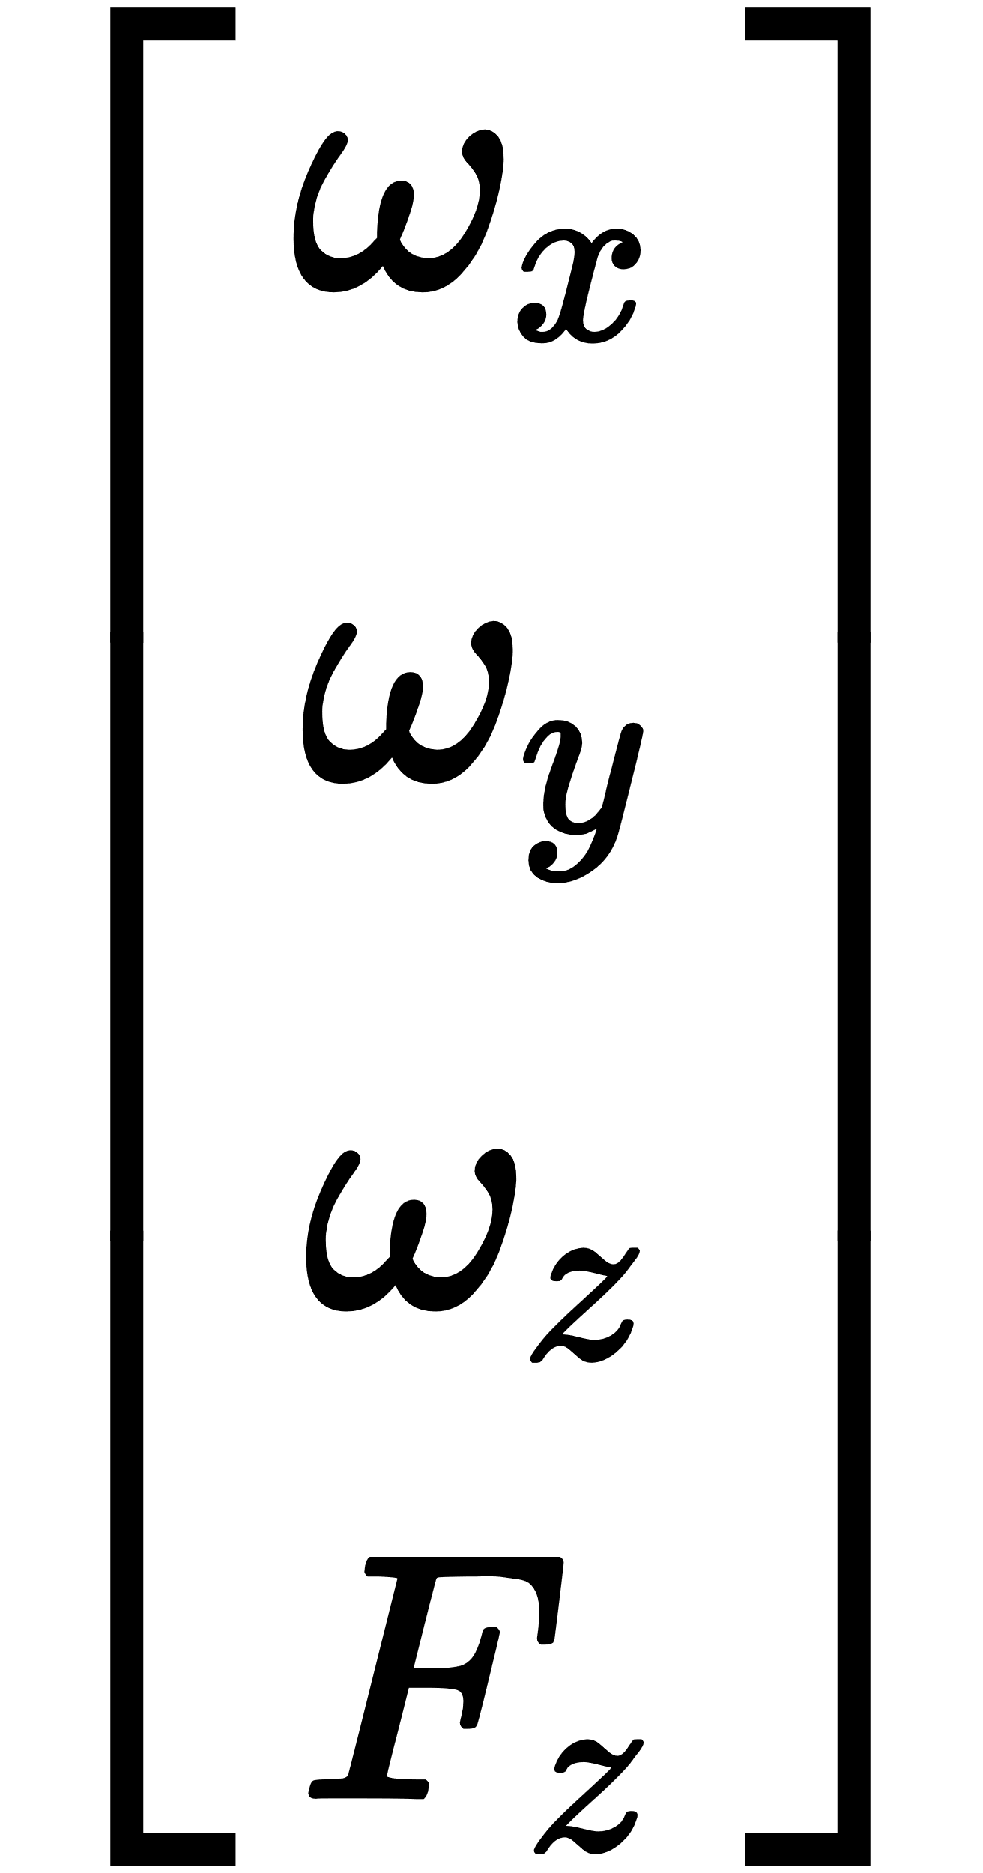
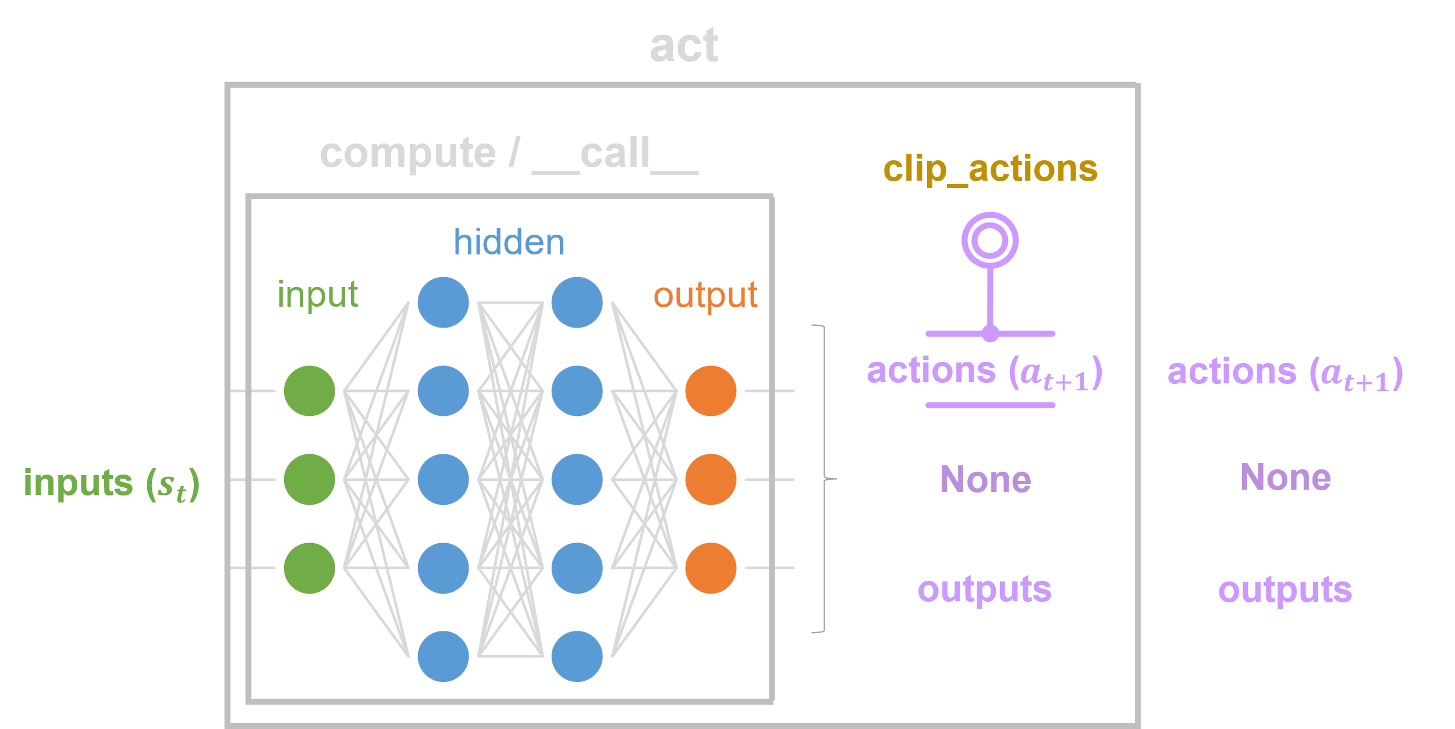
Reaching a target – SKRL Model
Observations
Shared Model
Position
Actor Model – Gaussian MLP
Actions
Orientation
Angular Velocities
Controller
Critic Model – Deterministic MLP
Thrust
Linear Velocities
Angular Velocities
Environment
Agent

Slide 8
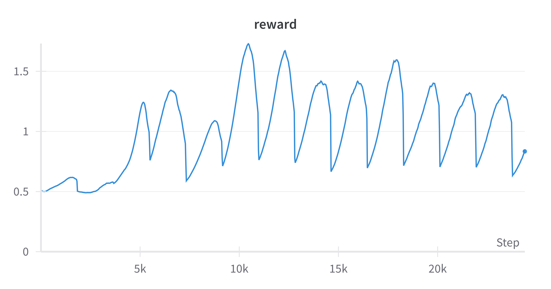
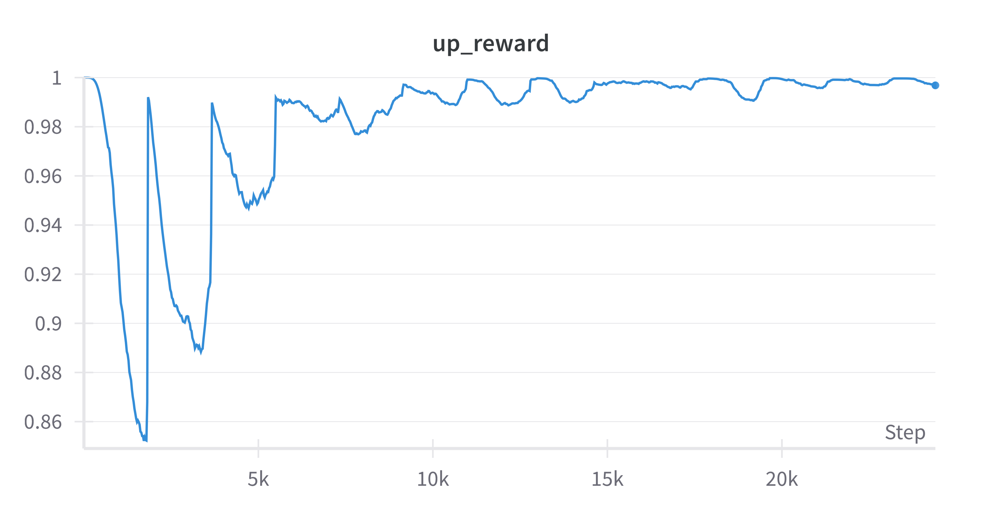
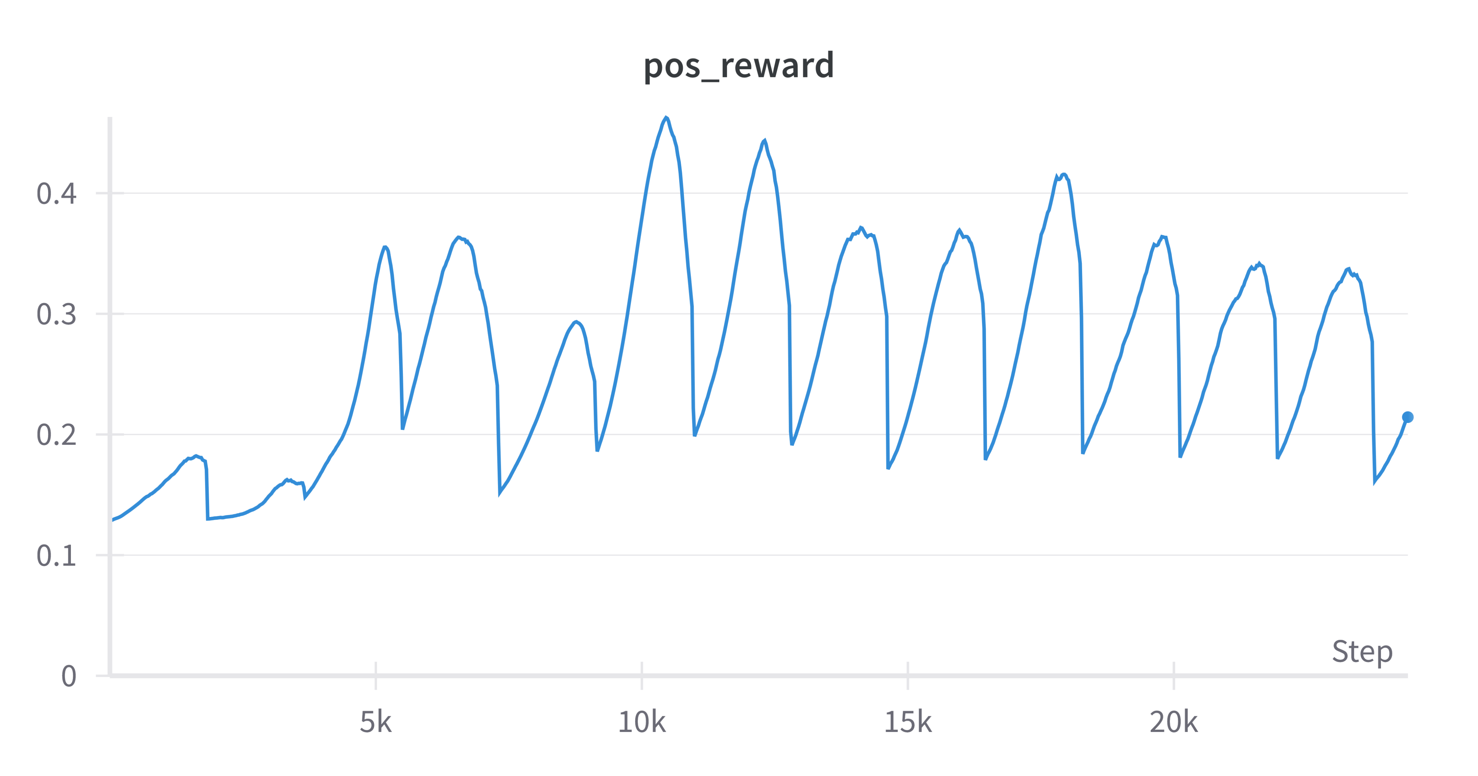
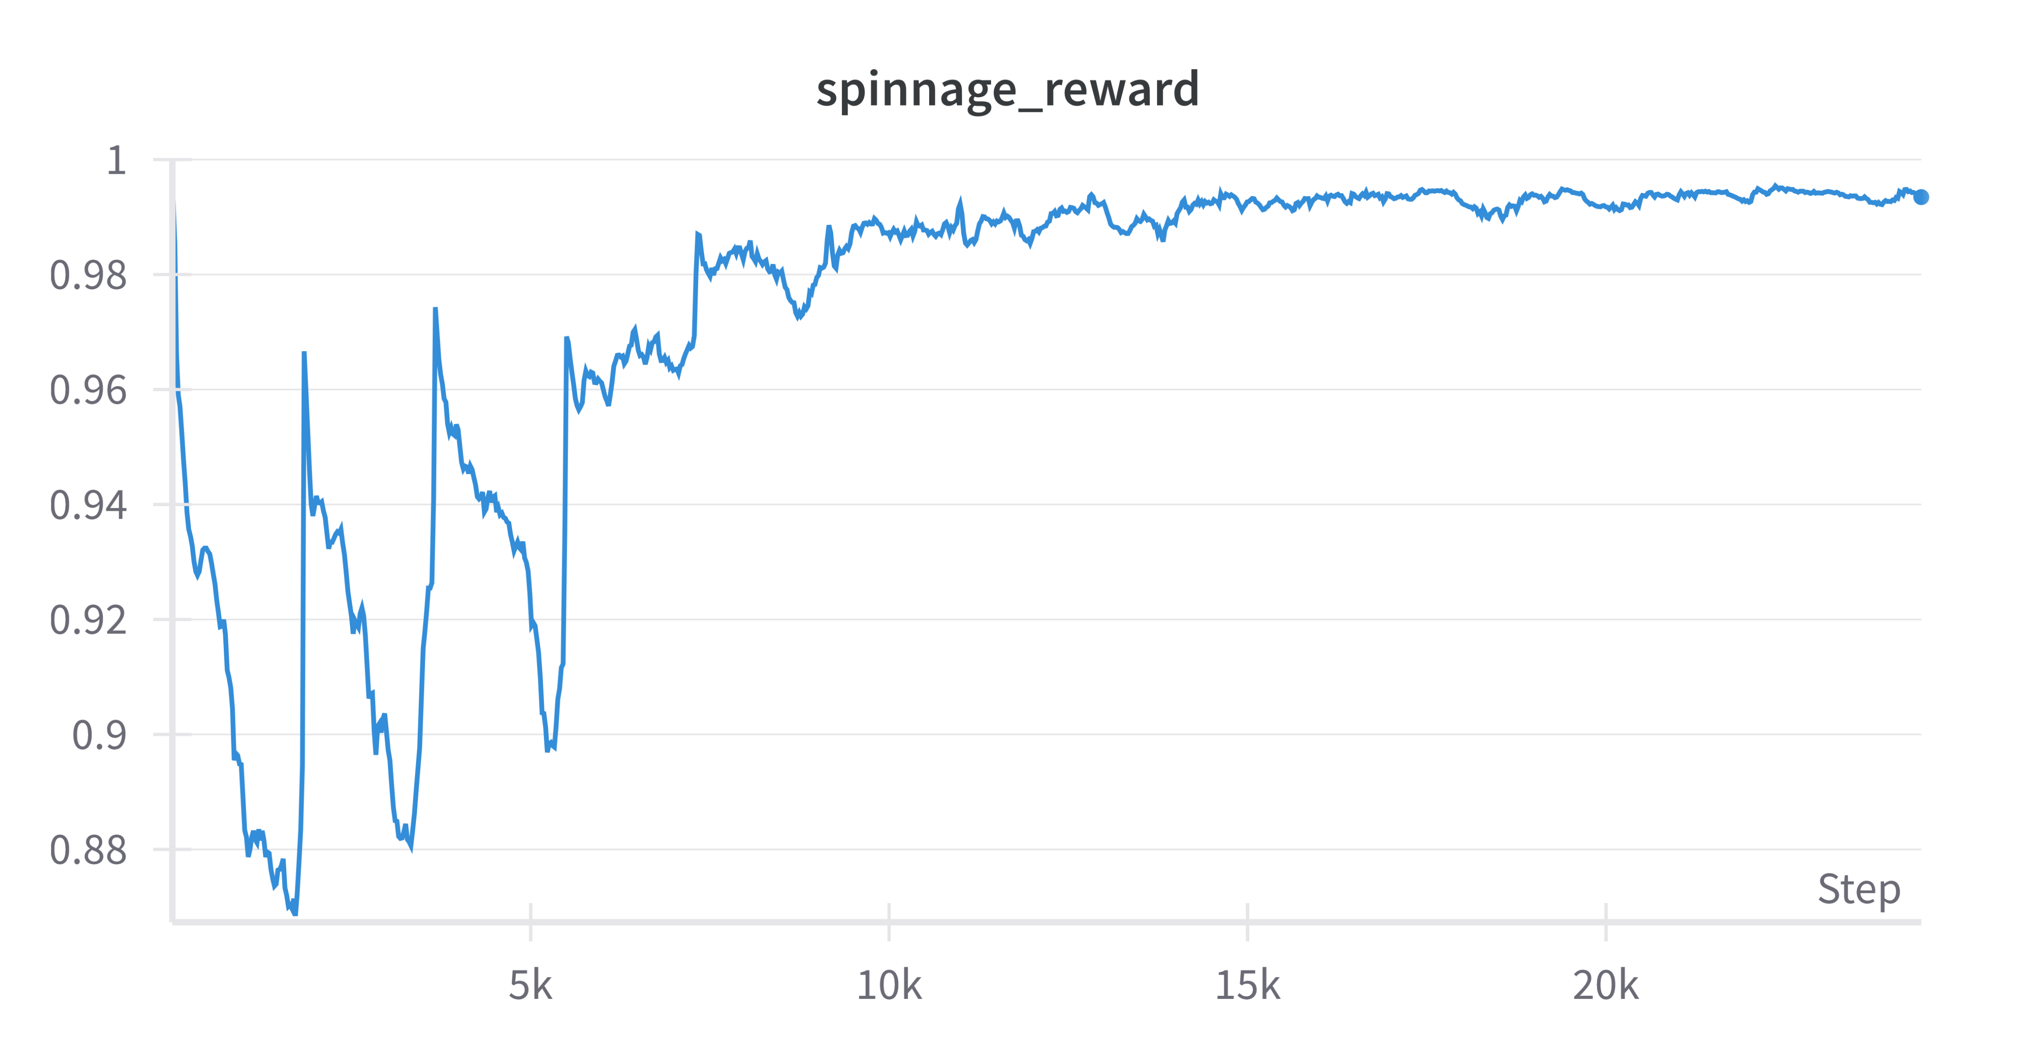
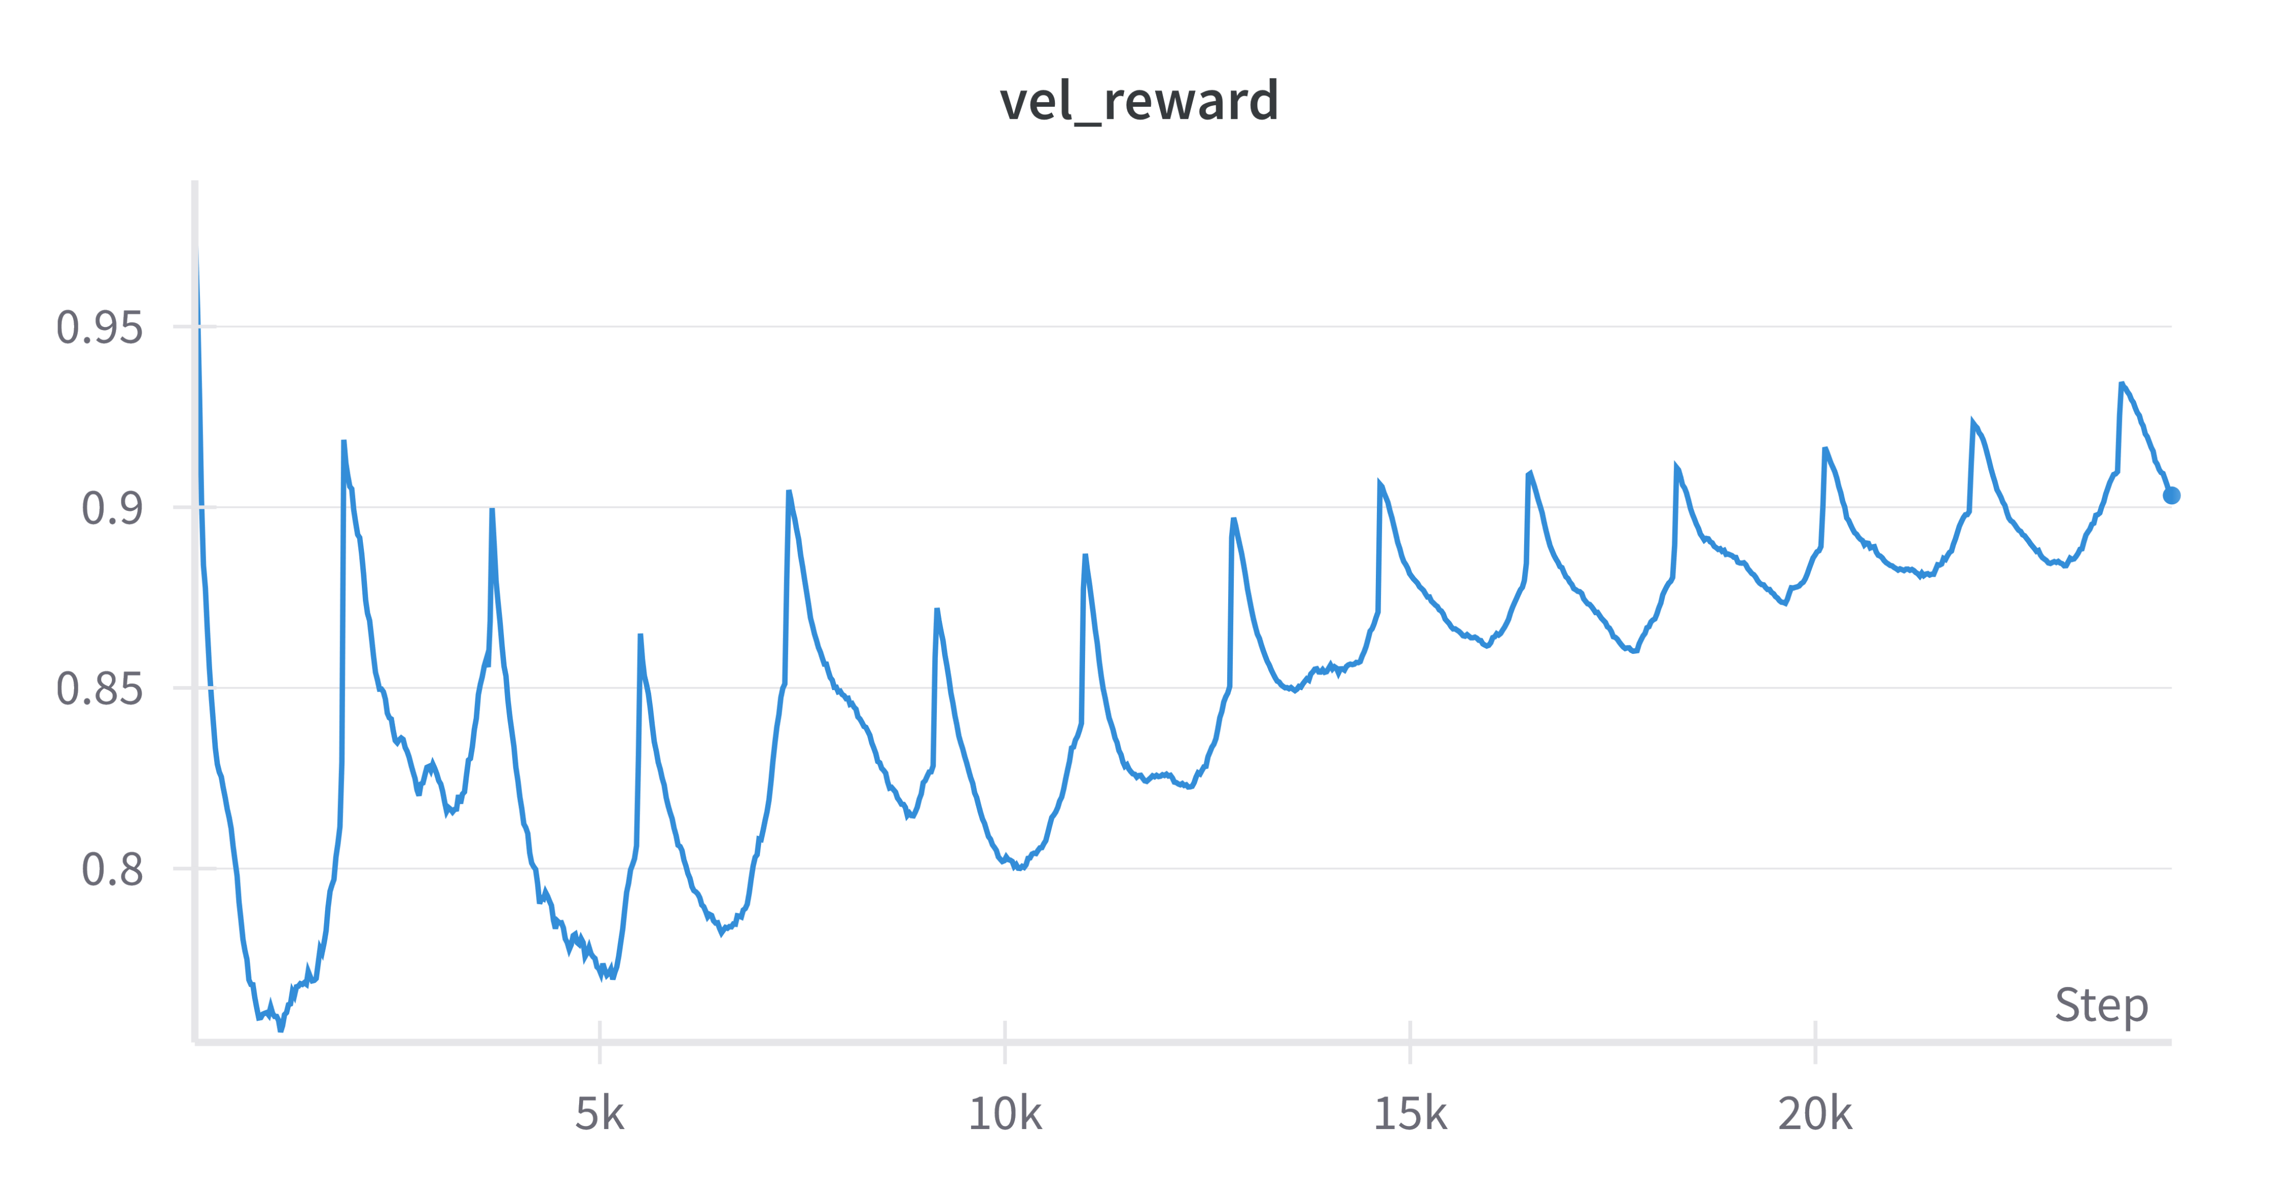
Reaching a target – Reward Function
Total Reward
=
Stability Reward
x
Position Reward
+
Position Reward
Uprightness Reward
Spinnage Reward
Velocity Reward

Slide 9
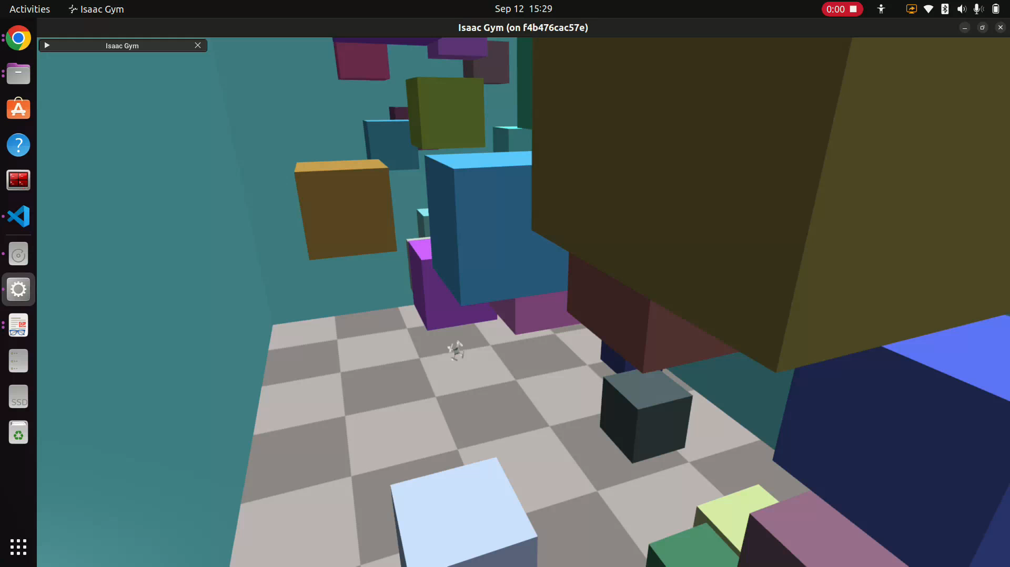
Reaching a target – Environment Reset
Reset conditions
Collision with the room walls or the room floor
Maximum episode length of 600 timestamp reached
Distance from the target greater than a certain threshold

Slide 10
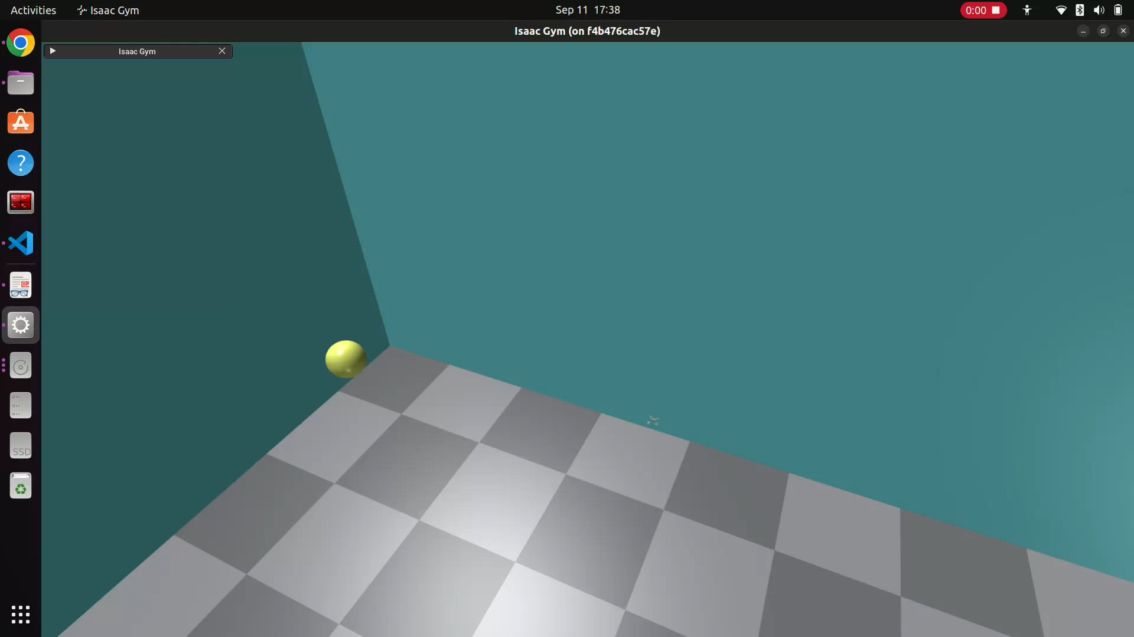
Reaching a target - Demo

Slide 11
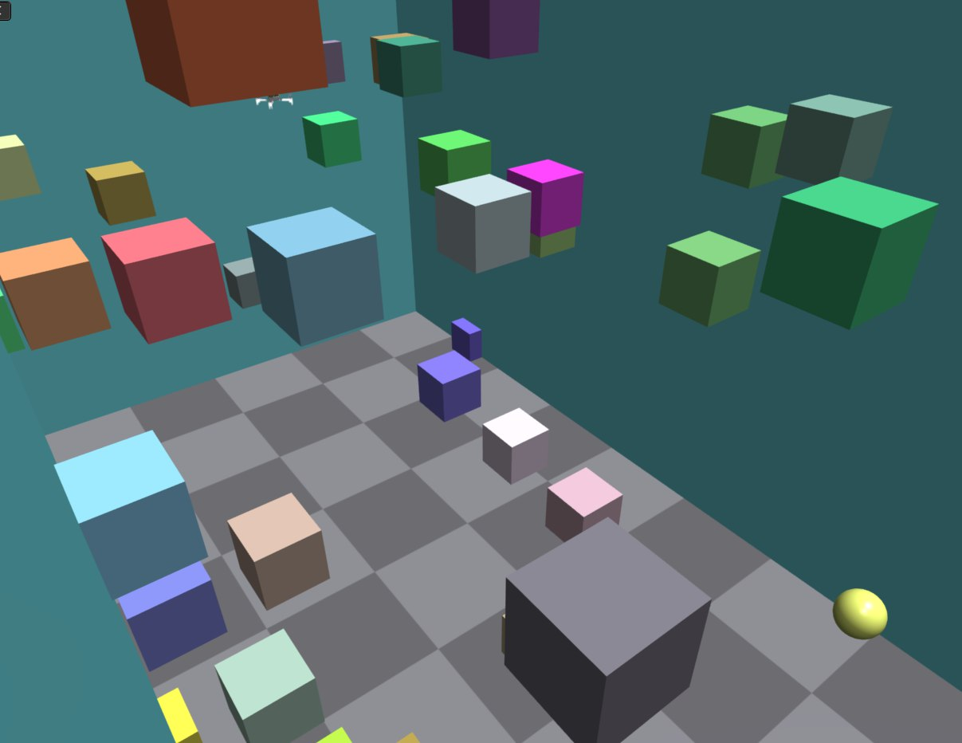
Vision-based navigation
Goal: reach a yellow sphere in a simulated rectangular room using only the camera sensors while avoiding collision with either the walls, the floor or a set of randomly placed cubic obstacles and without excessive movements
1
2
3
4
Environment Creation
Camera Sensors Data Collection
SKRL Model Implementation
Reward Function Definition
5
Task Simulation & Training

Slide 12

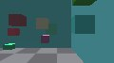
Vision-based navigation – Cameras
quadrotor_cameras.py
1
⚠️
Cameras are sensors not actors
2
create_envs
post_physics_step
Depth camera
Render cameras
Create camera sensor and attach to drone agent
Color camera
Retrieve images
from GPU
Store reference to GPU image tensor
Resolution: 120x67

Slide 13
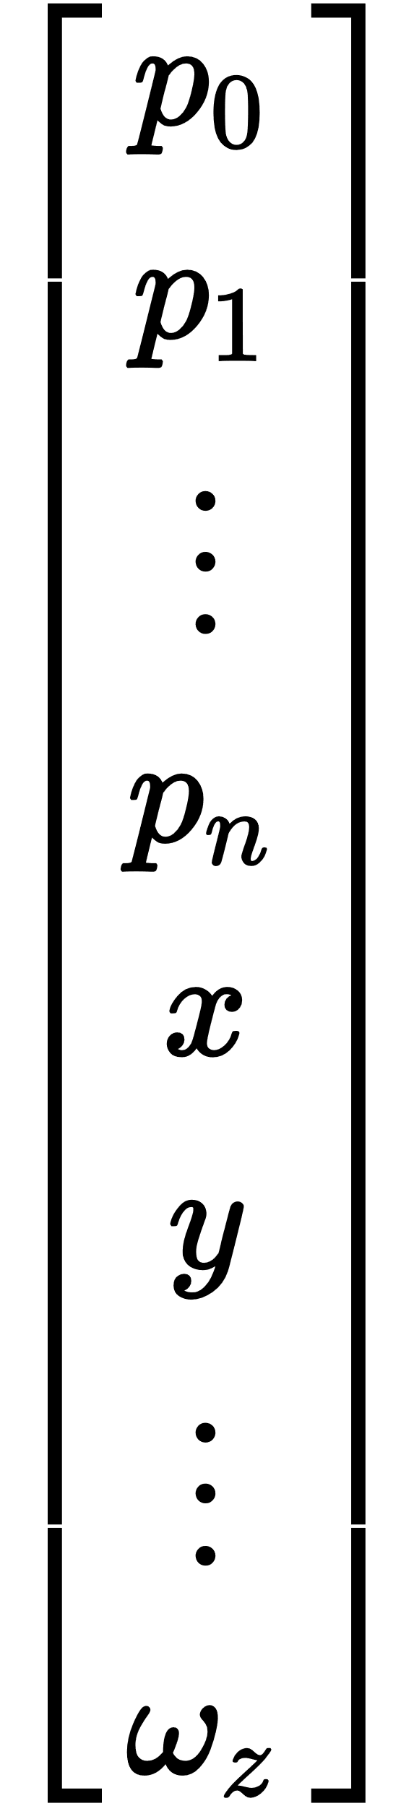
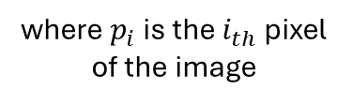
Vision-based navigation – SKRL Model
Observations
Actor Model – Gaussian CNN
Flatten Image
Actions
Angular Velocities
Controller
Drone States
Critic Model – Deterministic MLP
Thrust
where $p_{i}$ is the $i_{th}$ pixel of the image
Environment
Agent

Slide 14
Vision-based navigation – Issues
 | Hovering | Obstacle avoidance
Num. Envs. training | 2048 | 32
Iterations/s | ≈10 | ≈3
Max envs | 16384 | 200
Insufficient exploration
Slow learning
Higher variance in Gradient: learning unstable
The more complex the task, the greater the number of environments required.

Slide 15


Recap
SKRL API Application: Learned how to train and test reinforcement learning agents using the SKRL API.
Practical skills acquired:
Project Organization: manage projects using GitHub for version control and collaboration
Linux OS: installing libraries, managing dependencies
Docker Utilization: managing containers, configuration of virtual memory.
WandB Integration: Learned how to monitor experiments.
Python Programming: Improved coding abilities with a focus on modularity and readability.
IsaacGym API: Acquired experience in creating custom environments for RL and GPU-accelerated computing
SKRL API Application: Learned how to train and test reinforcement learning agents.
PyTorch Library : Learned how to build neural networks.
Knowledge acquired:
Proximal Policy Optimization RL algorithm
Reward Function Design for RL

Slide 16
Thank you for your attention

